Slide 1
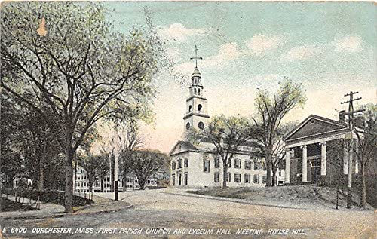
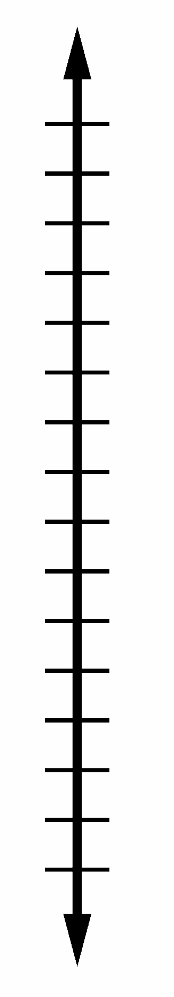
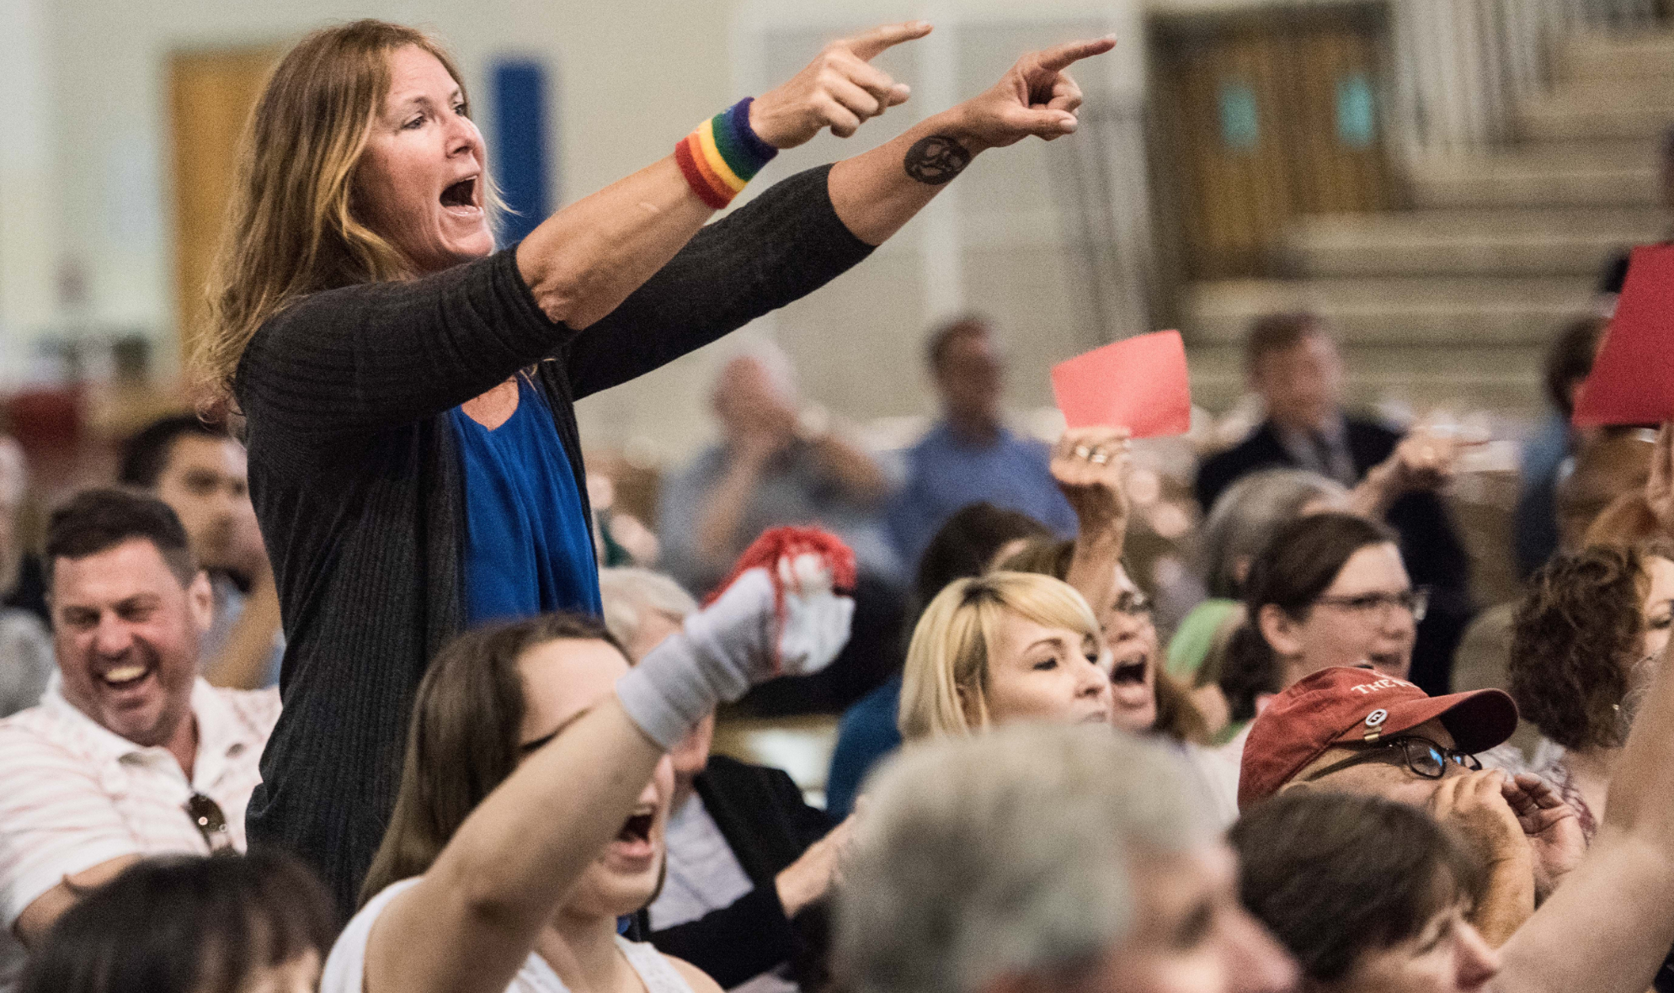
1633
Now
Notes:
The first town hall meeting was held in Dorchester, Massachusetts in 1633. Citizens of the town walked to the local city hall building. There the town talked about issues that impacted their town. And issues that impact your town are personal. These decisions impact the traffic you encounter on your way to work, and your property value, and if you want to raise your children in this town. Fast forward to now and town meetings are still held across the country. As you can see in the photo here, people can get heated. Organizing and providing input makes a difference. We’re going to talk about an issue that is dividing the Richmond community tonight.

Slide 2
Richmond Casino Proposals
Alexis Richards
Brenna Mayer
Bryce Bowels
Chris Pirrello
Grace Zhang

Slide 3
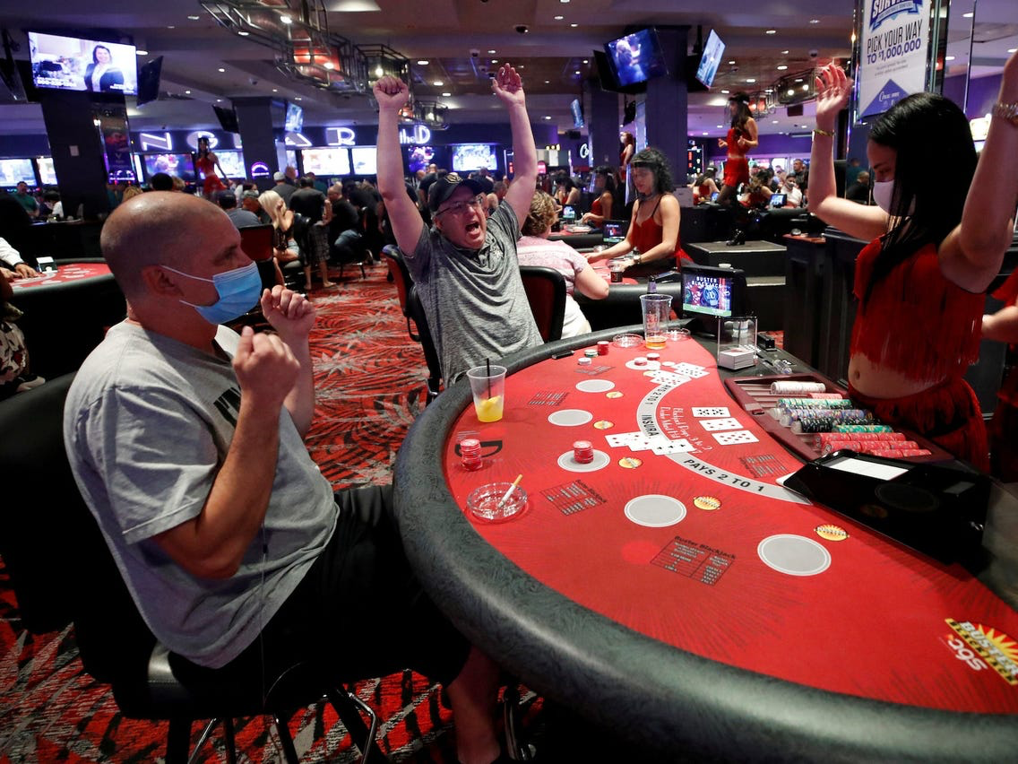
Introduction - The Situation
Northam signs casino legislation
Richmond narrows Casino proposals down to 3
Public has opportunity to provide input to city
Public weill vote on casino referendum
Notes:
Here’s a timeline of the situation. Obviously people who live near the build sites of the three proposals have some strong feelings. Now, let’s talk about the data involved in this public narrative.

Slide 4
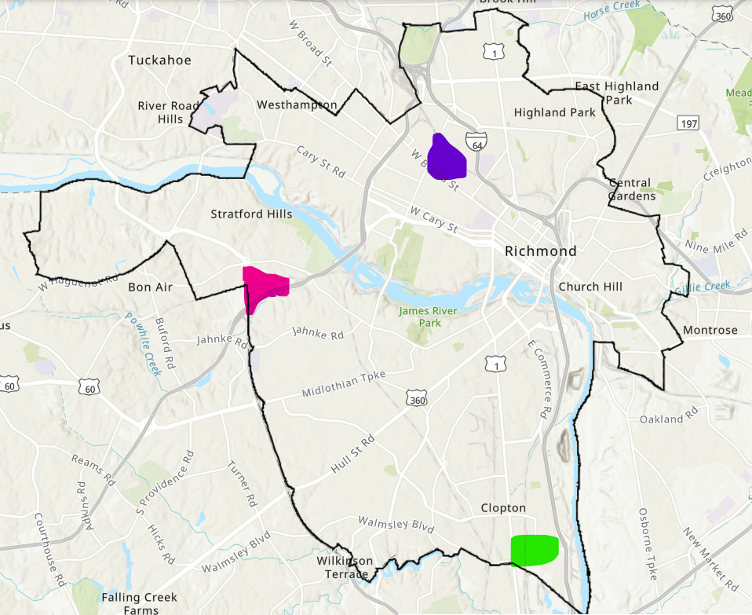
City of Richmond - Casino Coordinates
Live! Casino & Hotel
Bally’s Casino & Resort
ONE! Casino

Slide 5
Data
 | Bally’s Casino | ONE Casino | Live! Casino & Hotel
Economic Impact (10 Year) | $5.3B | $5.7B | $7.5B
Size | 1.6M Sq.Ft. | 0.95M Sq. Ft. | 1.9M Sq. Ft.
Interesting Fact | 6,000+ Jobs | 50+ Minority Investors 50% Minority Hiring | $60,000 Average Annual Wage

Slide 6
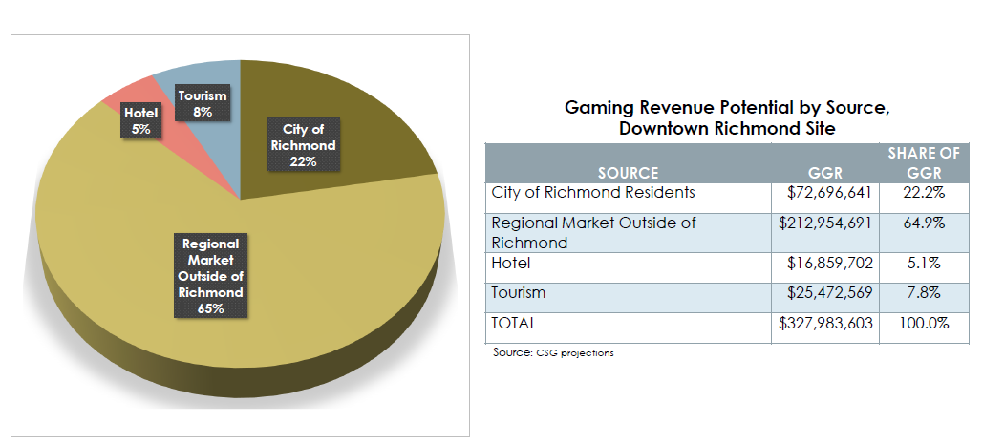
Source of Gaming Revenue
Notes:
No PIEs tho!

Slide 7
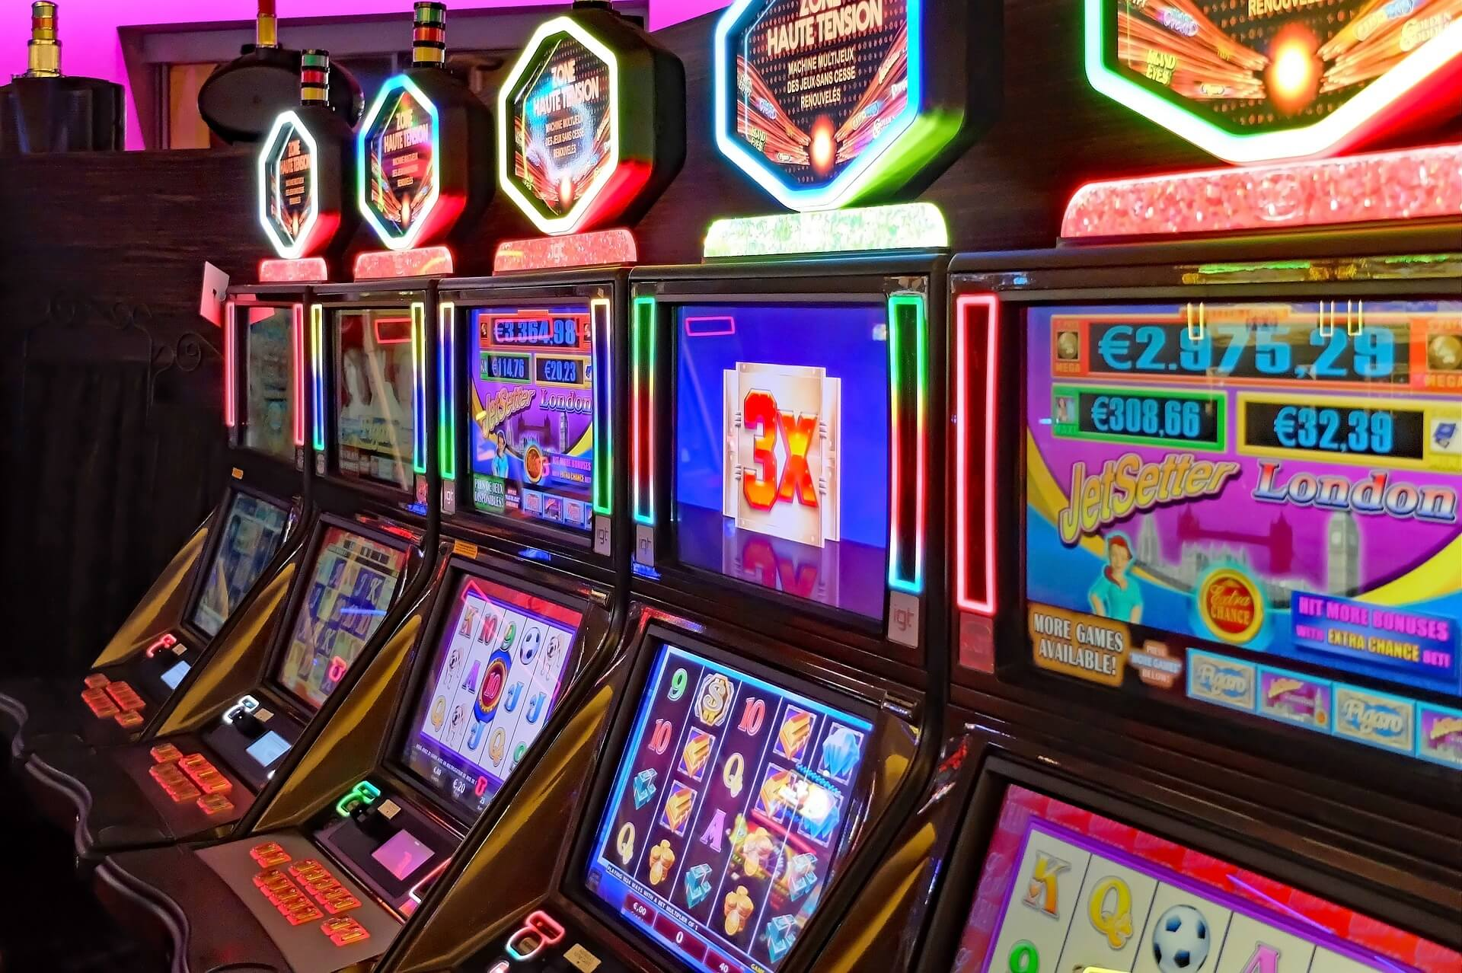
Benefits
Economic growth
Significant annual revenues
Employment opportunities
Bally’s Resort & Casino
Job training and internships
2,000 jobs
Opportunities for local retailers
One Casino
Only black owned casino in the country
1,500 jobs
Live Casino & Hotel
8,000 jobs (construction & permanent)
Highest grossing Casino entertainment resort
Notes:
The addition of a casino in the Richmond area could be beneficial to the community. I have highlighted some overall benefits and individual benefits that each resort could potentially provide.
The casino promises economic growth and significant annual revenues and also has potential to bring a lot of new employment opportunities to the Richmond area that we would not otherwise have.
Bally’s resort & casino will provide 2,000 jobs. They will also partner with historically black colleges and universities and offer job training, management training and internships to give them more opportunities for the future. It also has the potential to bring business to local retailers as detailed in the proposal. There would also be incentives for gamers and rewards redeemable at local retailers.
One Casino is the only black owned casino in the country and will provide 1,500 jobs to the area.
Live Casino & hotel will bring 8,000 jobs construction jobs and permanent jobs and is the highest grossing casino entertainment resort.

Slide 8
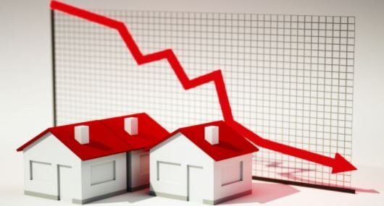

Frustrations
Property value decline
- Foreclosures and Short Sale
Addiction - Gambling, Substance Abuse
Traffic - Drunk Driving, Local Commute
Notes:
http://www.nocasinos.org/wp-content/uploads/2015/07/NationlAssocationRealtors-Casino-Research.pdf
External obsolescence also known as economic obsolescence is a term usually used in real estate valuation, meaning that the value of the real properties are negatively affected by the surroundings in this the proposed casino. According to a study conducted by the National Association of Realtors, a casino could negatively impact the home prices nearby by 2 to 10%. Also the number of foreclosures and short sale rise by .88 per 1,000 households with the arrival of a casino.
Approximately 1.2% of U.S. adults are pathological gamblers, and that figure doubles in a local community if a casino is located within 50 miles. Many people who develop gambling addictions also develop problems with drugs and alcohol. alcohol disorders have been found to have the greatest link to gambling addiction, and alcohol is served at most casinos.
“Results indicate that there is a strong link between the presence of a casino in a county and the number of alcohol-related fatal traffic accidents,” reports the study, which was performed by economists form the University of Wisconsin, Oshkosh, and the College of Charleston. Specifically, the study found that alcohol-related fatal accidents jumped by 9.2 percent in counties with casinos.
http://walkerd.people.cofc.edu/360/AcademicArticles/JHE.pdf

Slide 9
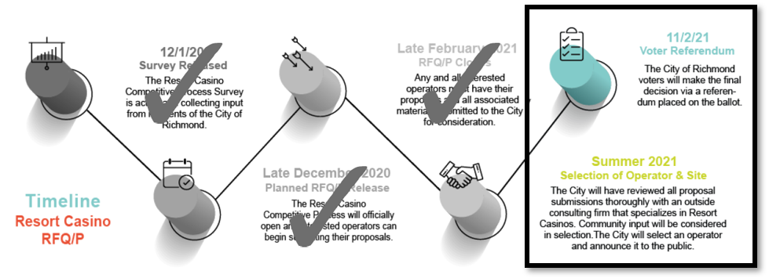
https://www.rva.gov/economic-development/resort-casino
Notes:
Last two steps are left
Department of Economic Development (DED) will Decide which Operator & Site
Vote in November on your local Richmond ballot
To get more information, you can visit this website for updated meetings and updates
Email feedback
https://www.rva.gov/sites/default/files/2021-03/Casino RFQ RFP Presentation - Market Analysis.pdf

Slide 10
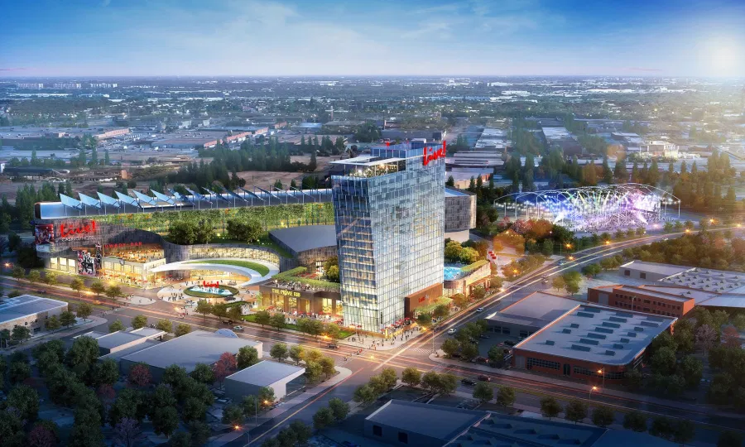
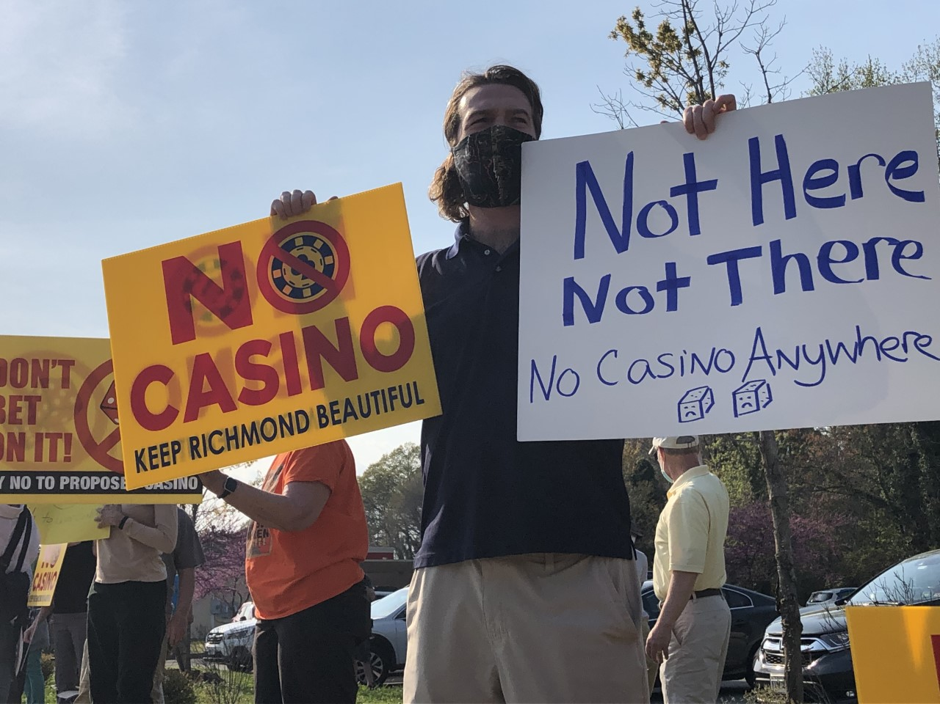
Are You For a Casino in Richmond or Against it?
https://www.rva.gov/economic-development/resort-casino
Notes:
Thank you for listening, please let us know if you have any questions!

